Slide 1



Performance Analysis and Power Allocation for
Covert Mobile Edge Computing With RIS-Aided
NOMA
Authors: Yanyu Cheng, Jianyuan Lu, Dusit Niyato, Fellow, IEEE, Biao Lyu, Minrui Xu, and Shunmin Zhu
Publisher: IEEE Transactions on Mobile Computing
汇报人：陈璐
Notes:
使用 RIS 辅助 NOMA 进行隐蔽移动边缘计算的性能分析和功率分配

Slide 2
1
Introduction
In this paper,author apply covert communications to MEC to prevent information leakage, where two candidate technologies of 6G, reconfigurable intelligent surface (RIS) and non-orthogonal multiple access (NOMA), are adopted. Specifically, a legitimate transmitter sends messages to a pair of legitimate receivers, while a warden aims to detect whether the legitimate transmission exists. Author can hide the existence of the stronger-signal receiver transmission from a warden by exploiting the nature of NOMA, and use a jammer to further hide this existence.
First analyze the performance for the case of fixed power allocation between the legitimate transmitters and the jammer. The closed-form expressions for the minimum detection error probability and ergodic public/covert rates are derived. Then, author design a reinforcement learning (RL)-based power-allocation optimization algorithm that maximizes the sum rate while ensuring covertness, by optimizing the power allocation between the transmitters and the jammer.
自强不息 厚德载物
Central South University
Notes:
作者将隐蔽通信应用到MEC中，以防止信息泄漏，其中采用了可重构智能表面（RIS）和非正交多址（NOMA）两种技术。具体地说，合法的发送者向一对合法的接收者发送消息，而监视者的目标是检测是否存在合法的传输。我们可以通过利用NOMA的性质来隐藏更强信号接收器的传输的存在，并且使用干扰器来进一步隐藏这种存在。
首先分析了在合法发射机和干扰机之间分配固定功率的情况下的性能。推导出最小检测错误概率和遍历公开/隐蔽速率表达式。然后，设计了一种基于强化学习（RL）的功率分配优化算法，通过优化发射机和干扰机之间的功率分配，在确保隐蔽性的同时最大化总速率。

Slide 3
1
Introduction
To realize covert MEC in 6G, the application of covert communications to RIS-aided NOMA becomes crucial. The benefits of covert communications can be summarized as follows :
Covert communication provides a higher level of security than information-theoretic secrecy.With covert communications, the attacker does not know whether the transmission happens or not. As such, it cannot launch external attacks precisely.
Compared with encryption, the performance of covert communications does not depend on the capabilities of the adversary. In other words, if the adversary has stronger information processing capability, the achievable security level will not be degraded.
Covert communications can be implemented as an alternative or complementary solution to upper-layer security techniques such as steganography and encryption.
自强不息 厚德载物
Central South University
Notes:
隐蔽通信的好处如下
隐蔽通信提供比信息理论保密更高级别的安全性。通过隐蔽通信，攻击者不知道传输是否发生。
与加密相比，隐蔽通信的性能不依赖于对手的能力。也就是说，如果对手具有更强的信息处理能力，安全级别也不会降低。
隐蔽通信可以作为上层安全技术（如隐写术和加密）的替代或补充解决方案来实现。

Slide 4
2
Related Work
Paper | Related Work | Relevant content
Power efficient IRS-assisted NOMA | RIS-Aided NOMA | The beamforming vectors of the BS and RIS were optimized for RIS-NOMA systems. There can be a line-of-sight (LoS) link between a BS and an RIS since both BS and RIS are pre-deployed.
Intelligent reflecting surface assisted non-orthogonal multiple access | RIS-Aided NOMA | The LoS BS-RIS-user link was considered in RIS-aided NOMA systems, and the active and passive beamforming was jointly optimized.
Multi-hop RIS empowered terahertz communications: A DRL-based hybrid beamforming design | RIS-Aided NOMA | A hybrid beamforming scheme for multi-hop RIS-assisted ter- ahertz communication networks was designed to improve coverage.
Covert communication in downlink NOMA systems with random trans-mit power | Covert Communications | a covert transmission between the BS and the stronger-signal user was realized by utilizing a public transmission between the BS and the weaker-signal user.
Covert communica- tions in D2D underlaying cellular networks with power domain NOMA | Covert Communications | covert device-to-device (D2D)-based NOMA was investigated, where D2D transmission link is covert and the link between the BS and cellular user is public.
Covert non-orthogonal multiple access vehicular communications with friendly jamming | Covert Communications | covert NOMA-based vehicu-lar communications were considered and implemented by exploiting friendly jamming.
自强不息 厚德载物
Central South University
Notes:
在RIS辅助NOMA方面，主要是RIS辅助通信网络的混合波束成形方案以提高覆盖范围，在RIS辅助的NOMA系统中考虑了BS-RIS-用户链路，并联合优化了主动和被动波束形成。
在隐蔽通信方面，基于NOMA，利用BS与信号较弱用户之间的公共传输来实现BS与信号较强用户之间的隐蔽传输，并通过利用友方干扰来实现。
除了这些外，作者还做了关于MEC和NOMA的相关工作。

Slide 5
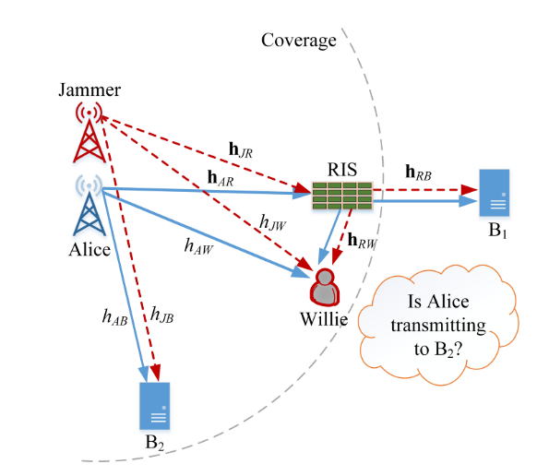
3
System Model
Channel Model
Quasi-static flat fading is considered for all channels.
The space of these vectors is N × 1.
We consider that all fading coefficients follow the Nakagami-m fading model with the fading parameters mχ, it is NLoS for mχ = 1 and is LoS for mχ > 1.
For the availability of CSI, we consider the following:
Alice perfectly knows the instantaneous CSI of the links of Alice-B2 and Alice-RIS-B1.
Alice also perfectly knows the instantaneous CSI of the links of Jammer-B2 and Jammer-RIS-B1.
Alice only possesses the statistical CSI of Alice-Willie and RIS-Willie links .
Willie possesses the perfect CSI of the Alice-Willie,Alice-RIS-Willie, Jammer-Willie, and Jammer-RIS-Willie links.
自强不息 厚德载物
Central South University
Notes:
我们考虑一个由合法发射器（Alice）、形成 NOMA 对的一对接收器（B1 和 B2）、RIS 和友方干扰器（Jammer）组成的系统，Alice-B2的传输是隐蔽的，而Alice-B1的传输是公开的。监视者（Willie）旨在检测 Alice 是否正在向 B2 发送消息。B2是小区中心接收器，可以直接与Alice通信，而B1是小区边缘接收器。由于Alice和B1之间由于距离较远且有物体阻挡而没有直接链路，因此部署了RIS来协助其通信。干扰器位于Alice旁边并由Alice控制，以降低Alice和B2之间的传输被Willie成功检测到的概率。
所有信道均考虑准静态平坦衰落。所有信道都会经历路径损耗。
对于CSI 的可用性，我们考虑以下因素： • Alice 完全知道Alice-B2 和Alice-RIS-B1 链路的瞬时CSI。 • Alice 也完全知道Jammer-B2 和Jammer-RIS-B1 链路的瞬时CSI • Alice只拥有Alice-Willie和RIS-Willie链路的统计CSI。• Willie 拥有Alice-Willie、Alice-RIS-Willie、Jammer-Willie 和Jammer-RISWillie 链路的完美CSI。

Slide 6
3
System Model
Signal Model
Alice transmits the signal sequence，we assume the fixed power allocation between two receivers and set α1 > α2.
Jammer sends the interference signal sequence,The jamming power is a random variable.
At B1, its message is detected directly by regarding B2 signal as interference.
At B2, the signal of B1 is decoded first,the signal of B2 is decoded after implementing the SIC.
As an illegal warden, the purpose of Willie is to determine whether Alice is sending a message to B2 through Neyman-Pearson test based on the received signal sequence.
自强不息 厚德载物
Central South University
Notes:
爱丽丝发送信号序列，我们假设两个接收器之间的功率分配固定，并B1的功率分配系数大于B2.干扰器发送干扰信号序列,干扰功率是一个随机变量.在B1处，将B2的信号视为干扰，直接检测其消息，实现连续干扰消除后对B2的信号进行解码.作为非法监视者，Willie 的目的是根据接收到的信号序列通过 检验判断 Alice 是否正在向 B2 发送消息。

Slide 7

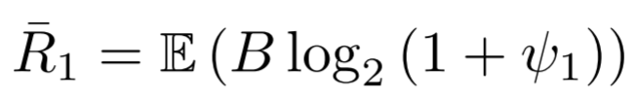

4
Performance Metrics
Detection Error Probability
The performance of Willie’s hypothesis test can be characterized by DEP, and its definition is
the false alarm probability
the miss detection probability
Ergodic Covert and Public Rate
The transmission between the Alice and B1 is public, and we define the corresponding date rate as public rate. The ergodic public rate of B1 is given by
The message to B2 is transmitted under covert communications, and the corresponding date rate is called covert rate. The ergodic covert rate of B2 is given by
自强不息 厚德载物
Central South University
Notes:
性能指标、检测错误概率、遍历隐速率与公开速率威利假设检验的表现可以用检测错误概率来表示,PFA 为误报概率，PMD 为漏检概率。
Alice和B1之间的传输是公开的，我们将相应的数据速率定义为公开速率。 B1 的遍历公开速率由下式给出
到B2的消息是在隐蔽通信下传输的，相应的数据速率称为隐蔽速率。 B2 的遍历隐蔽速率由下式给出

Slide 8

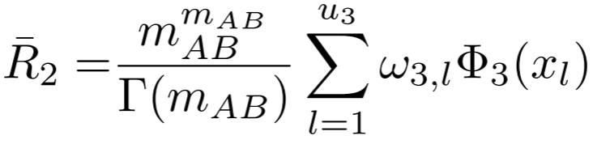
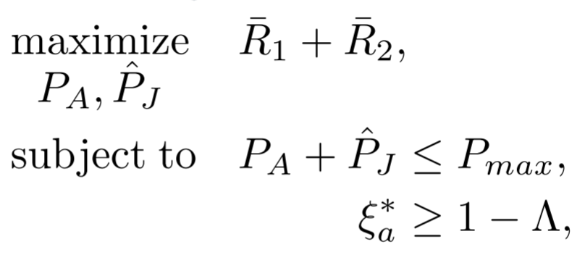
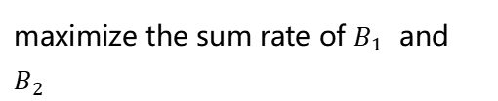
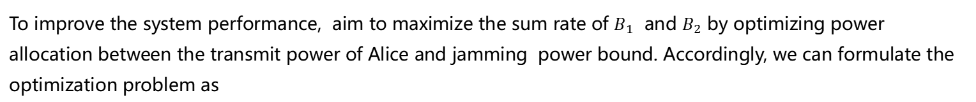
5
Performance Analysis For Ergodic Rates And Power Allocation
Fixed Power Allocation
Theorem . Given a $P_{A}$ and $P_{J}$, the ergodic public rate of $B_{1}$ is given by
The ergodic covert rate of $B_{2}$ is given by
Optimization Problem Formulation of Power Allocation
To improve the system performance, aim to maximize the sum rate of $B_{1}$ and $B_{2}$ by optimizing power allocation between the transmit power of Alice and jamming power bound. Accordingly, we can formulate the optimization problem as
maximize the sum rate of $B_{1}$ and $B_{2}$
the total power limit
the covert constraint
自强不息 厚德载物
Central South University
Notes:
遍历率和功率分配的性能分析,首先分析固定功率分配的场景。然后，考虑自适应功率分配的场景。同时，通过设计的基于强化学习的算法导出功率分配的最优解决方案。
固定功率分配。给定发射功率和干扰功率，B1的遍历公开率和B2的遍历隐蔽率由以下定理给出。为了提高系统性能，通过优化Alice发射功率与干扰功率之间的功率分配，使B_1和B_2的速率之和最大。因此，我们可以将优化问题表述为,是最大化B1和B2的总速率，Pmax 是总功率限制。

Slide 9

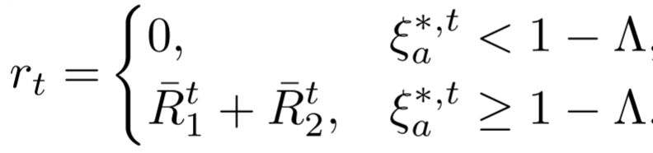
5
Performance Analysis For Ergodic Rates And Power Allocation
Methodology
Author consider using an RL-based method to derive the optimal power allocation,because the optimization parameter is continuous, author use proximal policy optimization (PPO).
State:
the ergodic covert rate
AMDEP
the ergodic public rate
Action:The action of the PPO policy at step t is κ.
Reward:The reward observed at the end of each step is set as follows:
自强不息 厚德载物
Central South University
Notes:
我们考虑使用基于强化学习的方法来导出最佳功率分配，由于优化参数是连续的，使用近端策略优化（PPO）.
状态包括最大总功率、隐蔽因子、平均最小检测错误概率、B1 的遍历公开速率和 B2 的遍历隐蔽速率。PPO 策略在步骤 t 的动作是功率分配系数κ,每一步结束时观察到的奖励设置如下：

Slide 10
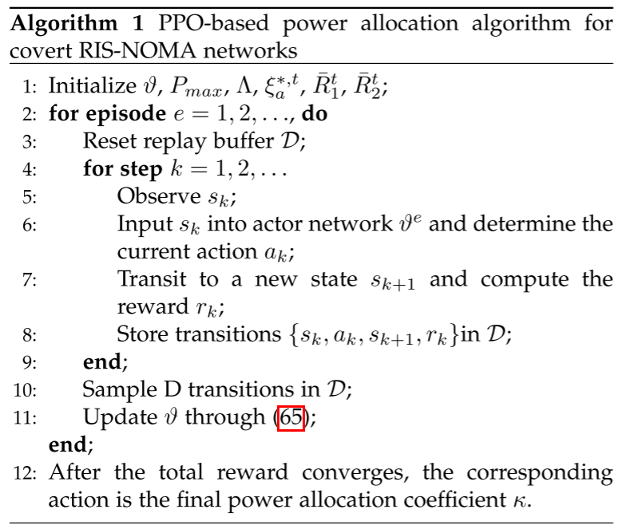
5
Performance Analysis For Ergodic Rates And Power Allocation
The PPO-Based Algorithm forPower Allocation Optimization
Basic Principles of PPO
Suppose that for any policy π, there exists a deterministic value function corresponding to it .
PPO algorithm can improve the strategy through policy iteration according to the feedback of value function without prior knowledge.
Then, the optimization objective is maximized by random gradient rising method, and the strategy and value function are updated accordingly.
自强不息 厚德载物
Central South University
Notes:
PPO基本原理：假设对于任何策略π，都存在与其对应的确定性价值函数。 PPO算法可以在没有先验知识的情况下，通过策略迭代，根据价值函数的反馈来改进策略。然后，通过随机梯度上升方法最大化优化目标，并相应更新策略和价值函数.
基于PPO的功率分配优化算法，观察状态，将状态输入到网络中确定动作，转移新的状态并计算奖励，使用这个算法，可以适当地为Alice和Jammer分配功率，使得总和速率最大化，同时保证隐蔽性能。总奖励收敛后，动作指示最终的功率分配系数，状态指示遍历公开率和遍历隐藏率。

Slide 11
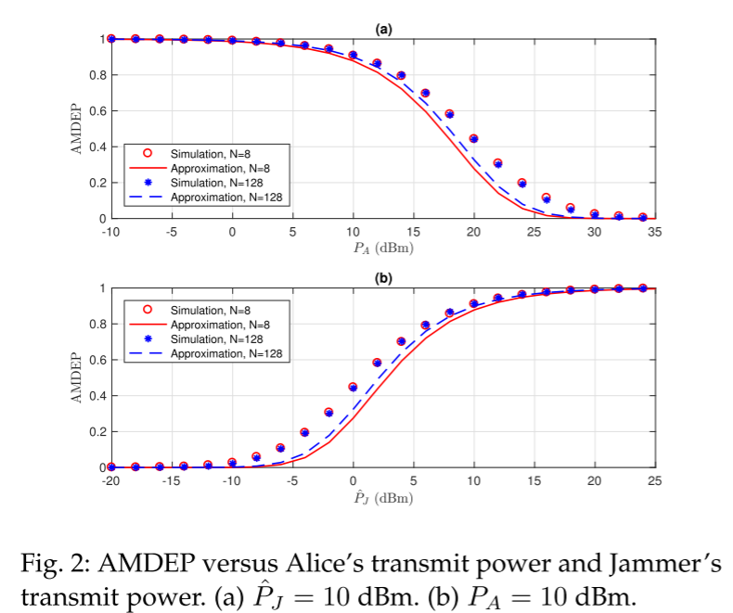
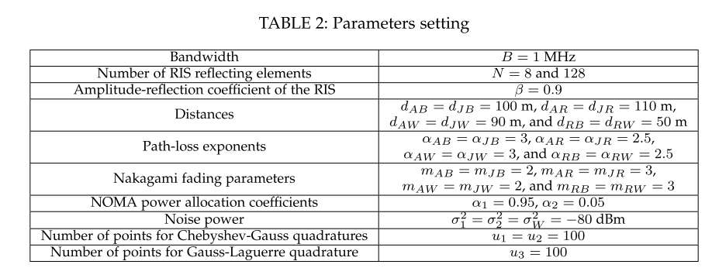
6
Numerical Results
Average Minimum Detection Error Probability
自强不息 厚德载物
Central South University
Notes:
平均最小检测错误概率，在图 2(a) 中绘制了 Willie 与 Alice 发射功率的 AMDEP 曲线，在图 2(b) 中绘制了 Willie 与 Jammer 发射功率的 AMDEP 曲线。对于 N = 8 和 N = 128 的两种情况，如图 2（a）所示，AMDEP 随着 PA 的增加而减小，如图 2(b) 所示，AMDEP随着干扰功率的增加。因为干扰功率与 发射功率之比越大，监视者 的不确定性就越大。我们还观察到，RIS 元件的数量对 AMDEP 的影响很小，因为干扰功率和 NOMA 的性质是影响隐蔽性能的主要因素。

Slide 12
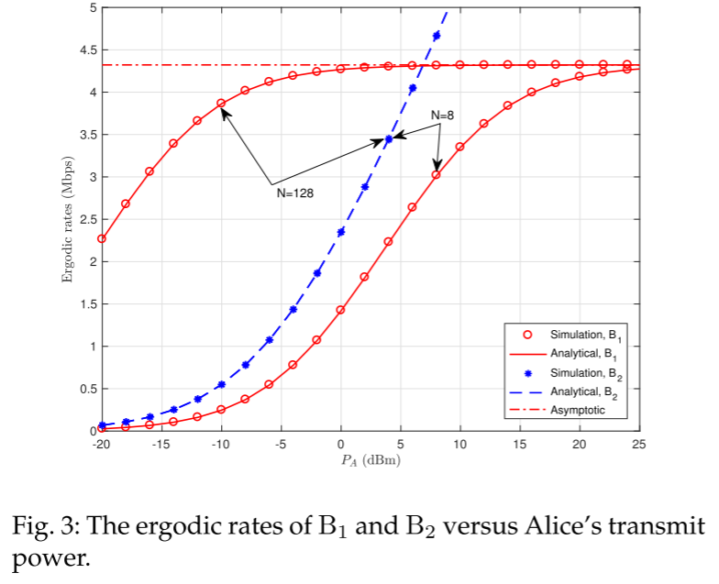
6
Numerical Results
Ergodic Public and Covert Rates
自强不息 厚德载物
Central South University
Notes:
遍历公开率和隐蔽率，B1和B2的传输分别是公开的和隐蔽的。图3中描绘了N = 8和N = 128的遍历公开率和隐蔽速率与Alice的发射功率的关系。首先，我们观察到遍历的公开率和隐蔽率的模拟点与分析得出的相应分析结果很好地匹配。然后，我们观察到B1的遍历公共率随着PA的增加而增加，并收敛。同时，B2的遍历隐蔽率总是随着PA的增加而增加。因此，B2的传输更值得隐蔽。此外，我们观察到，N的增加导致B1的遍历率在收敛之前的增加，而它对B2的遍历率没有影响，因为B2没有得到RIS的帮助。

Slide 13
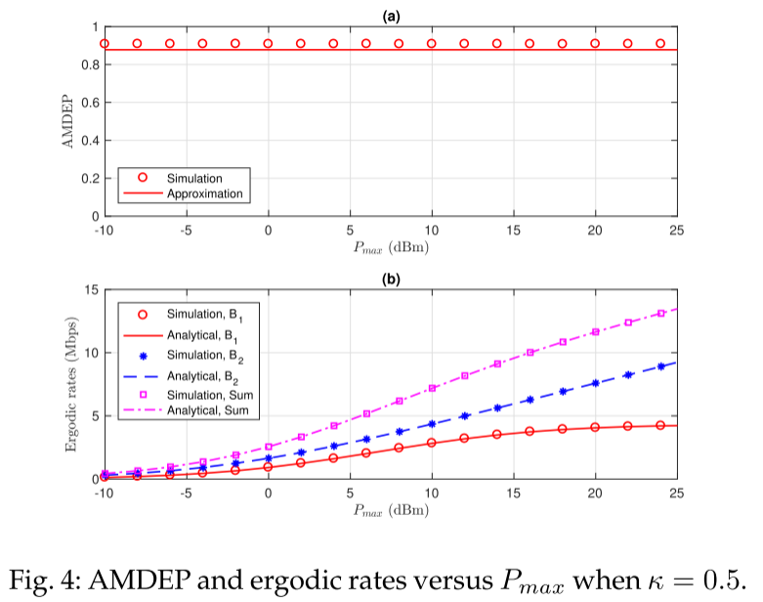
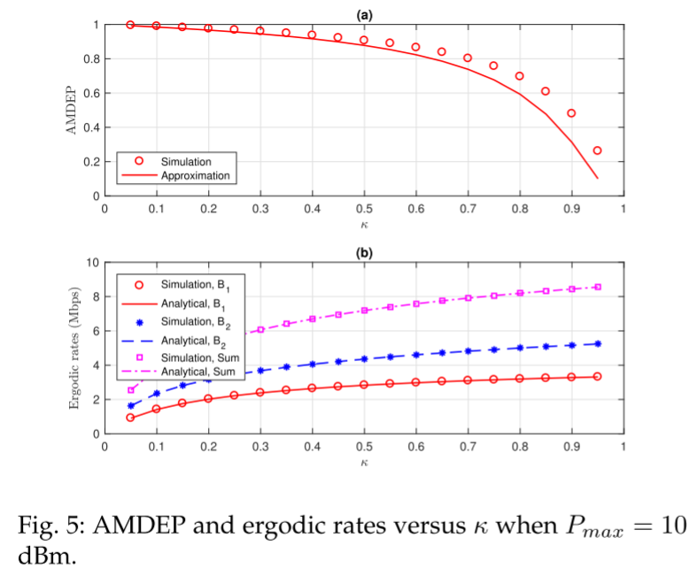
6
Numerical Results
Fixed Power Allocation
自强不息 厚德载物
Central South University
Notes:
对于固定的功率分配系数（κ = 0.5），我们在图4中绘制了两个接收器的AMDEP和遍历速率与Pmax的关系。我们观察到，AMDEP是不相关的Pmax，而两个接收机的遍历率和遍历率的总和Pmax的影响。B1的遍历率收敛到一个值，而B2的遍历率随着总功率极限而不断增加。
在图5中绘制两个接收机的AMDEP和遍历速率与κ的关系。我们首先观察到AMDEP随κ减小。具体而言，尽管AMDEP的近似误差随着κ而增加，但它仍然是可接受的。接收器的遍历率和总遍历率都随着 κ 的增加而增加。

Slide 14
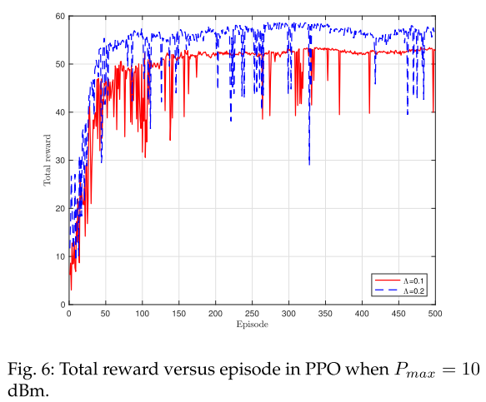
6
Numerical Results
Optimized Power Allocation
自强不息 厚德载物
Central South University
Notes:
优化功率分配：基于PPO的功率分配算法的训练过程如图6所示，我们观察到PPO的总回报在100集之后收敛。对于Λ = 0.1的收敛值低于对于Λ = 0.2的收敛值，因为较低的Λ揭示了较高干扰功率的要求，这导致较低的数据速率。收敛动作指示最终的功率分配系数，并且收敛状态暗示最终实现的AMDEP和遍历速率。

Slide 15
7
Contributions
Propose a novel covert MEC scheme with RIS-aided NOMA for security, where an RIS is used to expand cell coverage and a friendly jammer is applied to protect the transmission between the transmitter and the stronger-signal receiver.
Under the proposed scheme, the transmission between the transmitter and the stronger-signal receiver is covert and the transmission between the transmitter and the weaker-signal receiver is public.We analyze the performance of these two receivers and derive the closed-form expressions for ergodic covert rate and ergodic public rate.
Design a reinforcement learning (RL)-based algo-rithm that optimizes the power allocation between the transmitter and the jammer to maximize the sum rate of two receivers while ensuring a high AMDEP,and investigate the effectiveness of the designed algorithm.
自强不息 厚德载物
Central South University
Notes:
•提出了一种采用RIS辅助NOMA 的新型隐蔽MEC 方案，其中RIS 用于扩大小区覆盖范围，并采用友好的干扰器来保护发射器和更强信号接收器之间的传输。
• 在所提出的方案下，发射器和信号较强的接收器之间的传输是隐蔽的，而发射器和信号较弱的接收器之间的传输是公开的。我们分析了这两个接收器的性能，并推导了遍历隐蔽率和遍历公开率的封闭式表达式。
• 设计了一种基于强化学习（RL）的算法，优化发射器和干扰器之间的功率分配，以最大化两个接收器的总速率，同时确保高AMDEP，并研究所设计算法的有效性。

Slide 16

Thanks

